Slide 1
Design with Tri-State Buffers
GateCPU
CPU
GateMem
Memory
Shared Bus

Slide 2
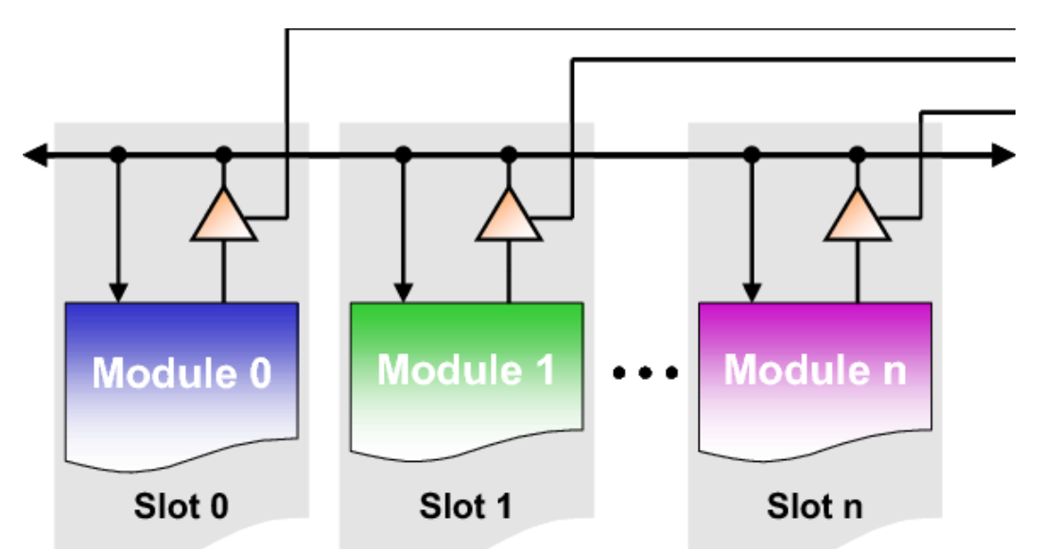
Bi-directional BUS
EN0
EN1
ENn
DataBUS
Input
path
Input
path
Input
path
Output
path
Output
path
Output
path

Slide 3
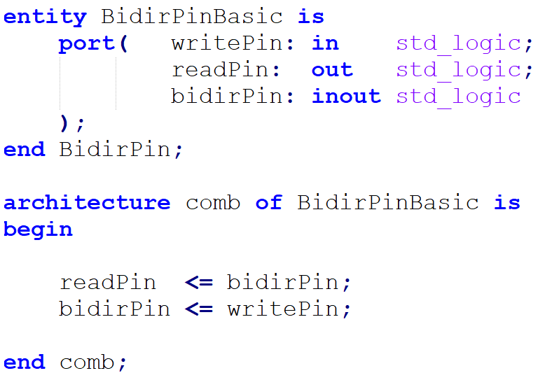
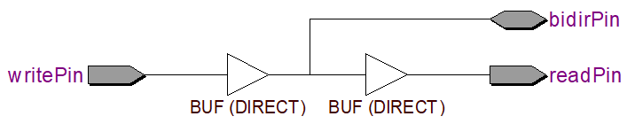
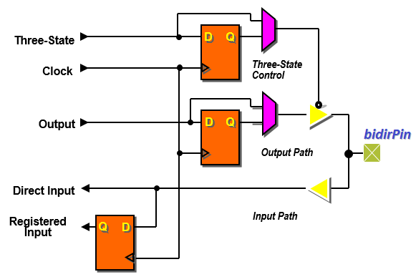
inout Pin synthesis - Bidirectional Pin
bidirPin
Cyclone II I/O Features
Reading and writing from inout module pin is synthesized via buffer (as shown in the above RTL synthesis)

Slide 4
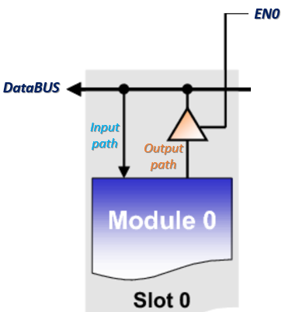
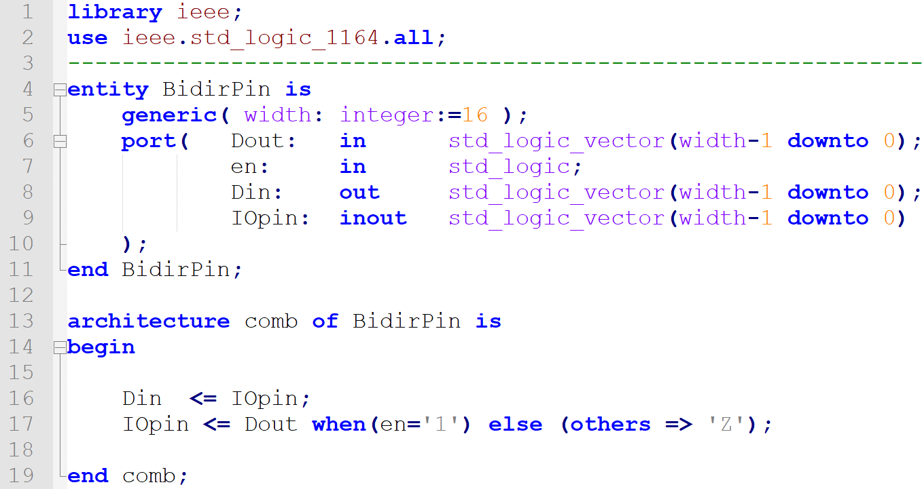
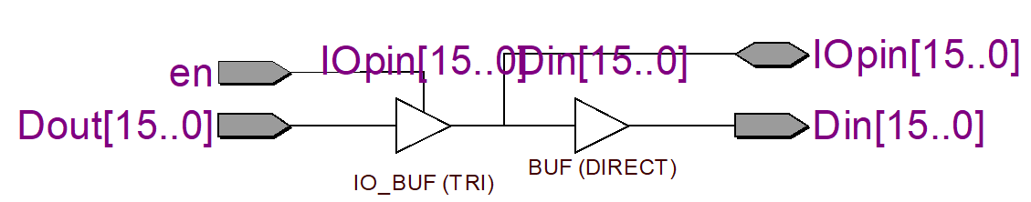
Bi-directional BUS
IOpin
en
Din
Dout
There is direct galvanic connection but via buffer

